Slide 1
Retail Store
Return Policy Change
Presented by:
Yingmin Wang, Yi Lu
Yiwen Zheng
Yuning Zhao, Randy Shi

Slide 2
CONTENTS
01
Part One
Background
02
Part Two
Problem Solve
03
Part Three
Limitation
04
Part Four
Appendix

Slide 3
CONTENTS
01
Part One
Background

Slide 4
Background
Returns reduce profits on average 5% to 6% for manufacturers and 4% for retailers (Accenture, 2011; Richardson, 2004). To get more profit , many companies have reduced their leniency of their return policy.

Slide 5
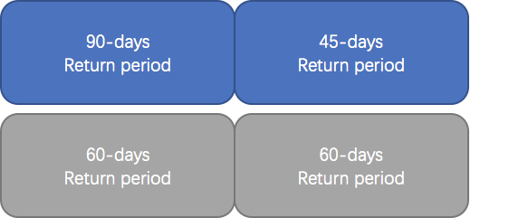

Background

Slide 6


Background
Before policy change After policy change
April 1st
2013
April 1st
2014
Policy Change on
October 1st, 2013

Slide 7
Research Question
Question 1: What is the impact of the policy change on online channel sales?
Question 2: What is the impact of the policy change on physical store sales?
Question 3: What is the impact of the policy change on online channel returns?
Question 4: What is the impact of the policy change on physical store returns?
Question 5: What is the impact of the policy change on product level online sales and returns as well as on product level physical store sales and returns?
Question 6: How does the impact of the policy change vary across product categories?

Slide 8
Research Questions
01
02
03
Impact
Impact
Impact
Online Sales
Store Sales
Online Returns
06
05
04
Category
Difference
Impact
Impact across product categories
Sales & Returns
Store Returns

Slide 9
CONTENTS
02
Part Two
Problem Solve

Slide 10
Research Question 1
What is the impact of the policy change on
online channel sales?

Slide 11
Sample Summary - Online Sales
Total Number = 960 (sample size)
Mean Max Min
Online sales value 103,682.1 2,133,233.0 0
Online sales quantity 638.9 13,074 1
Three online channel
#2 Primary brand #6 Secondary brand #10 Sister brand
Customer demographics
Seasonality (monthly, year)

Slide 12
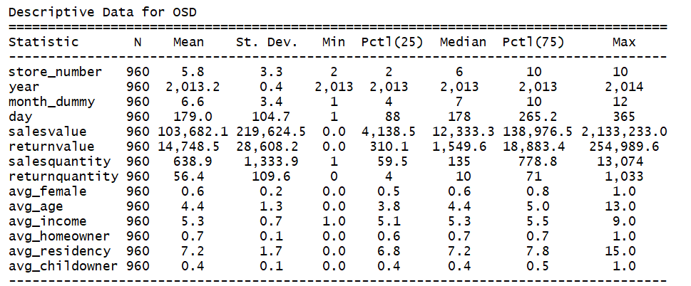
Variables - Online Sales
Dependent Variables:

Slide 13
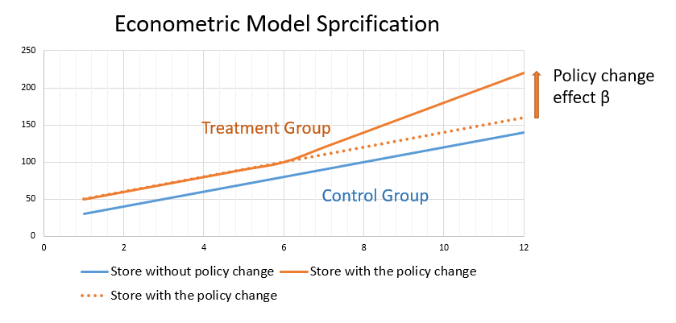
Econometrics Analysis

Slide 14
Theoretical Model
Variable Description
1 for Treatment group, return policy change
policy_change =
0 for Control group return, policy didn’t change
1 after policy change
month_group =
0 before policy change
For ONLINE Sales Value
ln(salesvalue) ~ month_group*policy_change + avg_female + avg_age
+avg_income + avg_homeowner +avg_childowner+ avg_residency

Slide 15
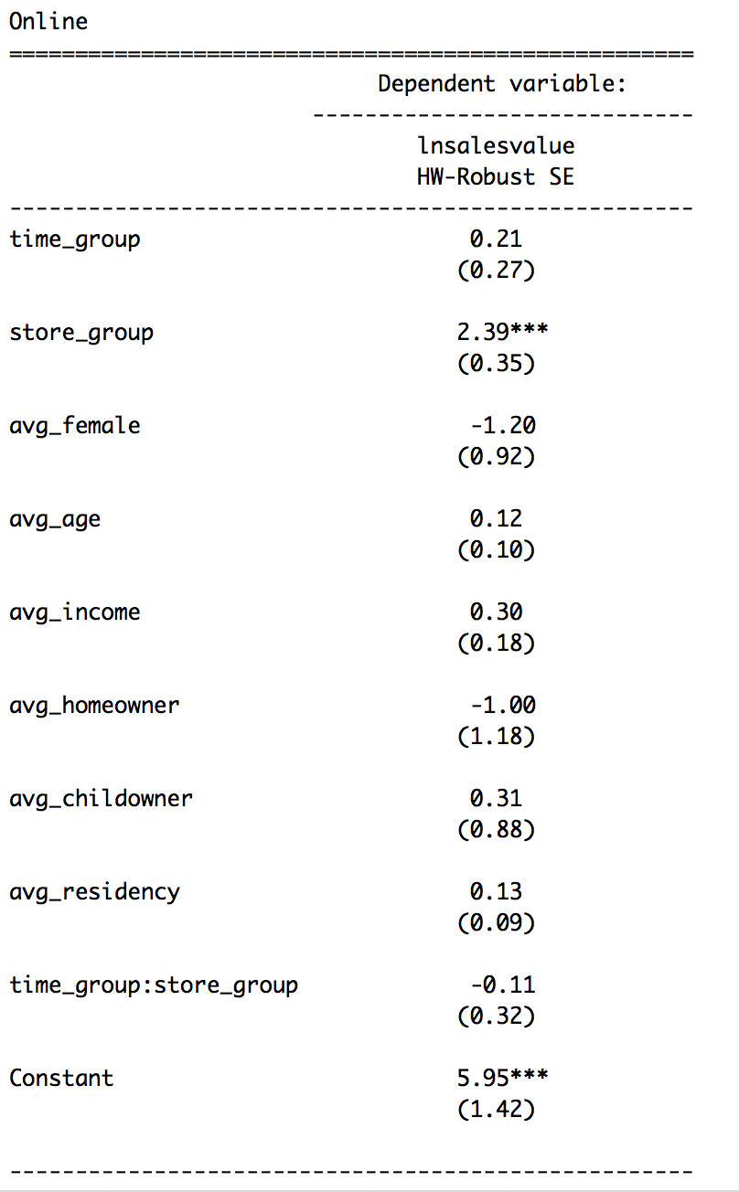
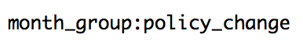
Results - Online sales value
1 Coefficient of interaction term
Is insignificant.
-0.11
(0.32)
Insignificant Impact

Slide 16
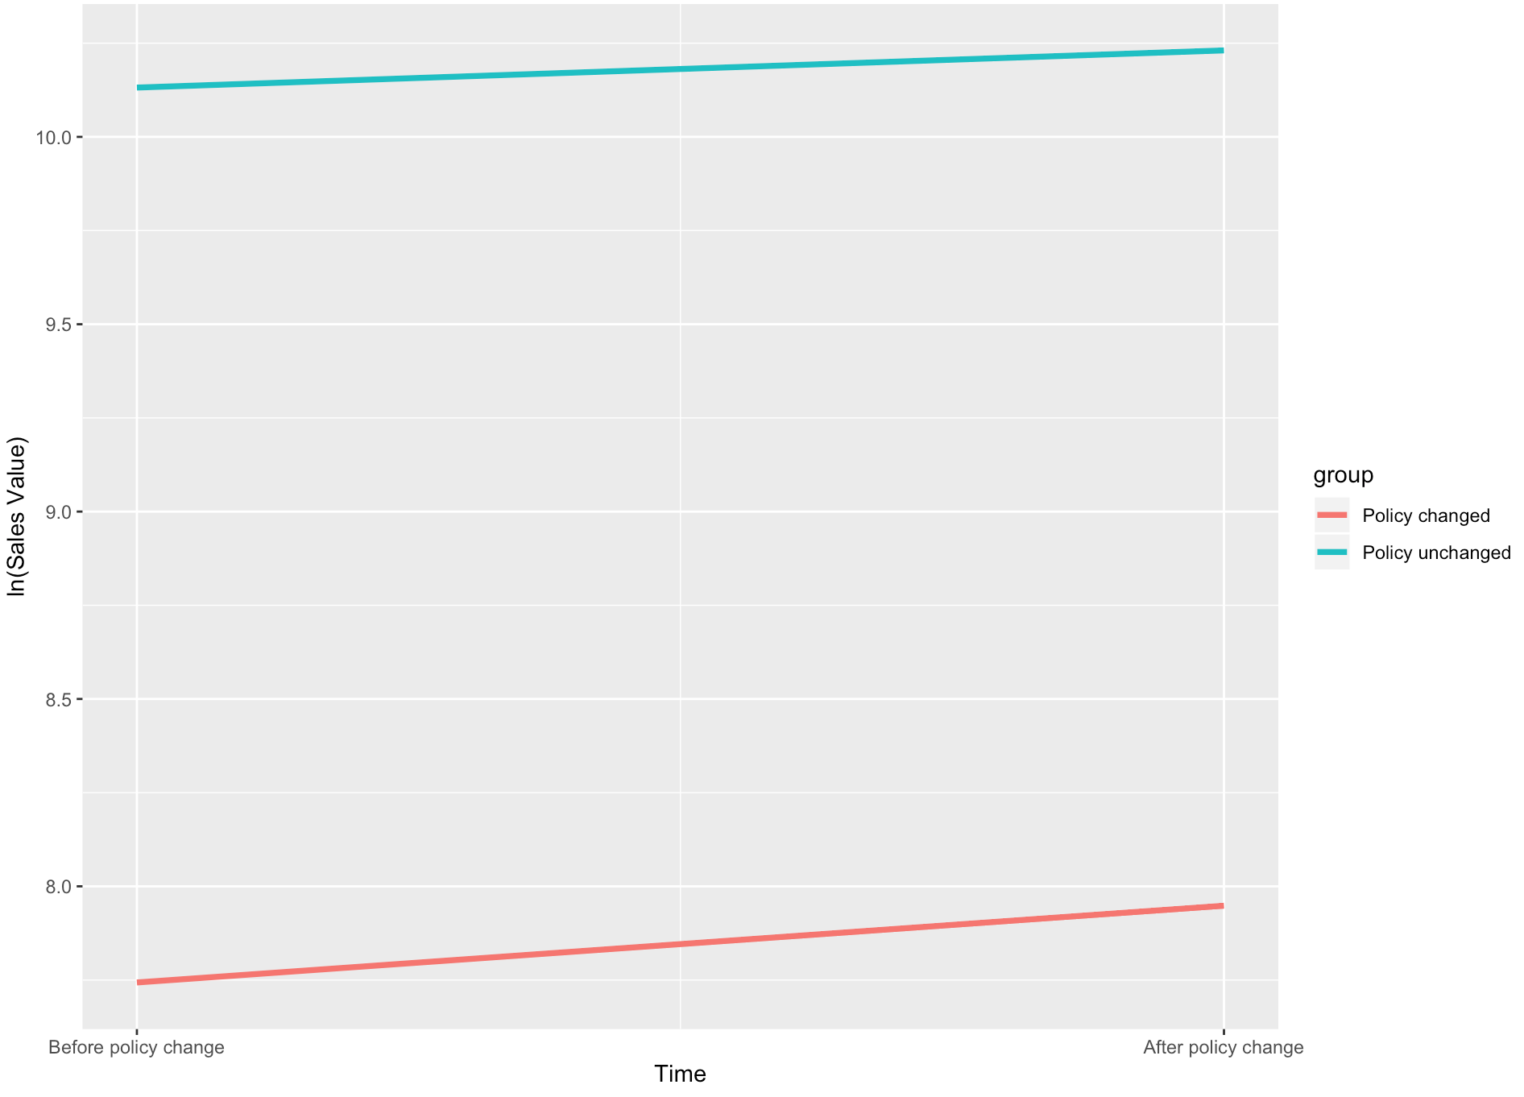
Results - Online sales value
2 Marginal Plot
Almost Parallel
Insignificant Impact

Slide 17
Theoretical Model
Variable Description
1 for Treatment group, return policy change
policy_change =
0 for Control group return, policy didn’t change
1 after policy change
month_group=
0 before policy change
For ONLINE Sales Quantity
Negative Binomial model
Salesquantity ~ month_group*policy_change + avg_female + avg_age +
avg_income + avg_homeowner + avg_residency +avg_childowner

Slide 18
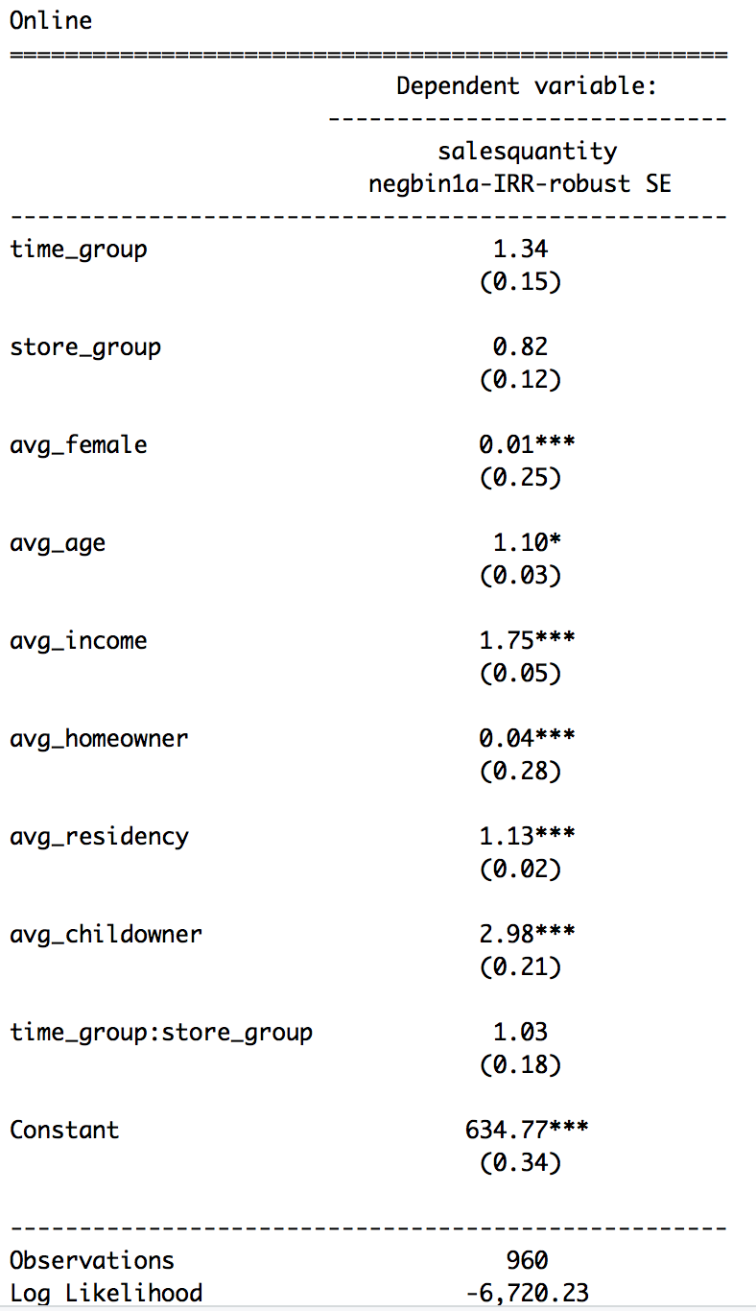
Results - Online sales quantity
1 Coefficient of interaction term
is Insignificant
1.03
(0.18)
Insignificant Impact

Slide 19
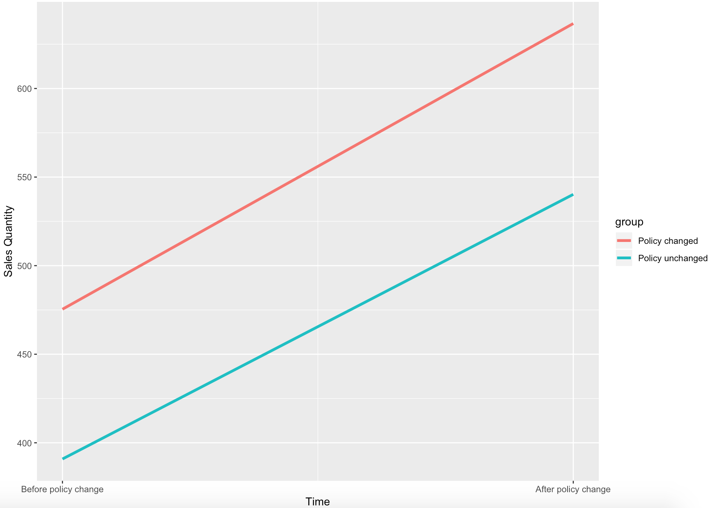
Results - Online sales quantity
2 Marginal Plot
Almost Parallel
Insignificant Impact

Slide 20

Conclusion - Online Sales
Return policy change has no significant impact on online sales value
Return policy change has no significant impact on online sales quantity.

Slide 21
Research Question 2
What is the impact of the policy change on
physical store sales?

Slide 22
Sample Summary - Store Sales
Total Number = 8957 (sample size)
Mean Max Min
Store sales value 77,197.3 1,040,980.0 23.0
Store sales quantity 290.8 2,823 1
Customer Demographics
Seasonality

Slide 23
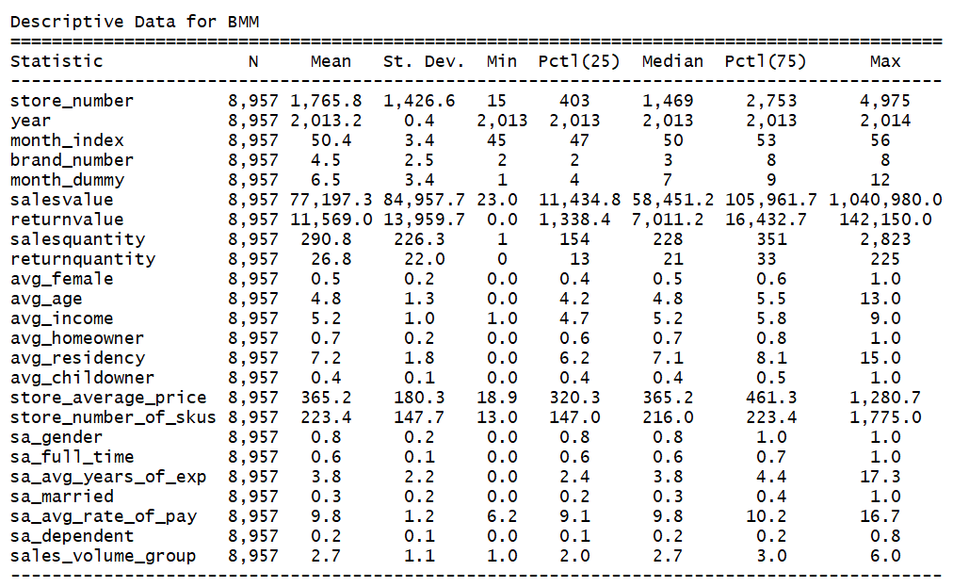
Variables - Store Sales
Dependent Variables:

Slide 24
Theoretical Model
Variable Description
1 for Treatment group, return policy change
policy_change =
0 for Control group return, policy didn’t change
1 after policy change
month_group =
0 before policy change
For STORE Sales Value
ln(salesvalue) ~ policy_change + month_group + avg_female +avg_age + avg_income + avg_homeowner + avg_residency + avg_childowner +store_average_price + log(store_number_of_skus) + sa_gender + sa_full_time + sa_avg_years_of_exp + sa_married + sa_avg_rate_of_pay + store_average_price+sa_dependent + policy_change * month_group

Slide 25
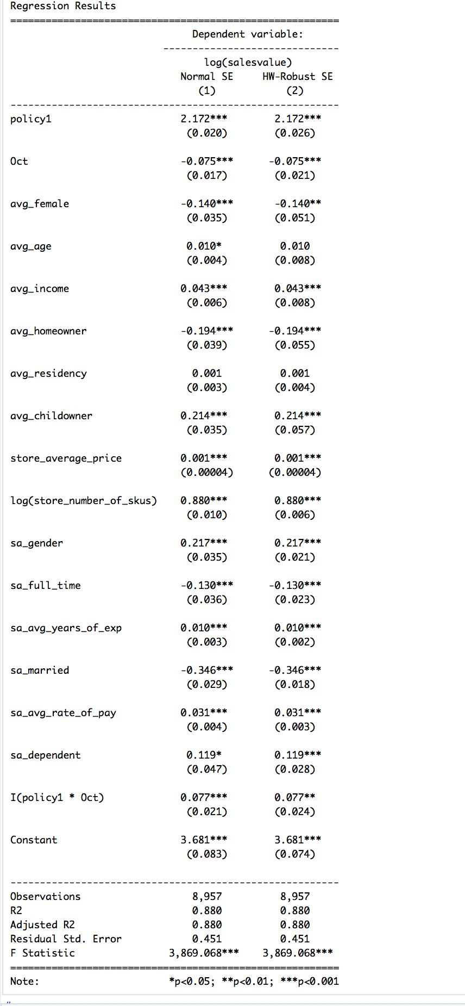
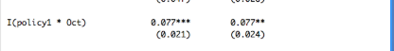
Results - Store sales value
Coefficient of interaction term
0.077**
(0.024)
7.7% increase in sales value
Significant Impact

Slide 26
Theoretical Model
Variable Description
1 for Treatment group, return policy change
policy_change=
0 for Control group return, policy didn’t change
1 after policy change
month_group =
0 before policy change
For STORE Sales Quantity
Salesquantity ~ policy_change + month_group + avg_female + avg_age + avg_income + avg_homeowner + avg_residency + avg_childowner + store_average_price + sa_gender + sa_full_time + sa_avg_years_of_exp + sa_married + sa_avg_rate_of_pay + store_average_price + sa_dependent +
policy_change * month_group

Slide 27
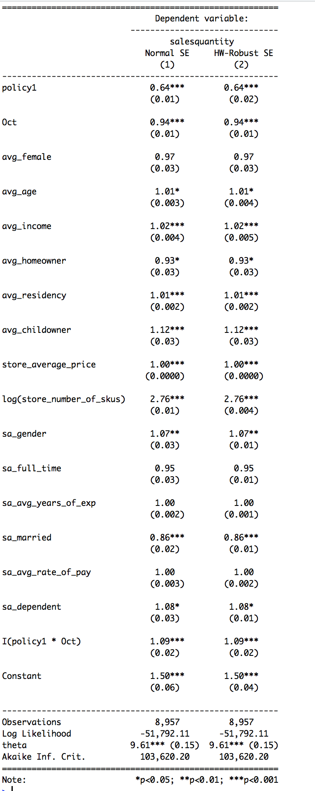
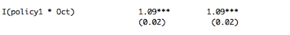
Results - Store sales quantity
Coefficient of interaction term
1.09***
（0.02)
9.0 % increase in sales quantity
Significant Impact

Slide 28

Conclusion - Store Sales
Return policy change lead to 7.7% increase in sales value
Return policy change lead to 9% increase in sales quantity
Store sell more cheaper products compared with old return policy

Slide 29
Research Question 3
What is the impact of the policy change on
online channel returns?

Slide 30
Sample Summary - Online Return
Total Number = 960 (sample size)
Mean Max Min
Online return value 14,748.5 254,989.6 0
Online return quantity 56.4 1033 0
Three online channel
#2 Primary brand #6 Secondary brand #10 Sister brand
Customer demographics
Seasonality (monthly, year)

Slide 31
Variables - Online Return
Dependent Variables:

Slide 32
Theoretical Model
Variable Description
1 for Treatment group, return policy change
policy_change =
0 for Control group return, policy didn’t change
1 after policy change
month_group =
0 before policy change
For ONLINE Return Value
ln(returnvalue) ~ month_group*policy_change + ln(salesvalue) +
avg_female + avg_age + avg_income + avg_homeowner + avg_residency
+avg_childowner

Slide 33
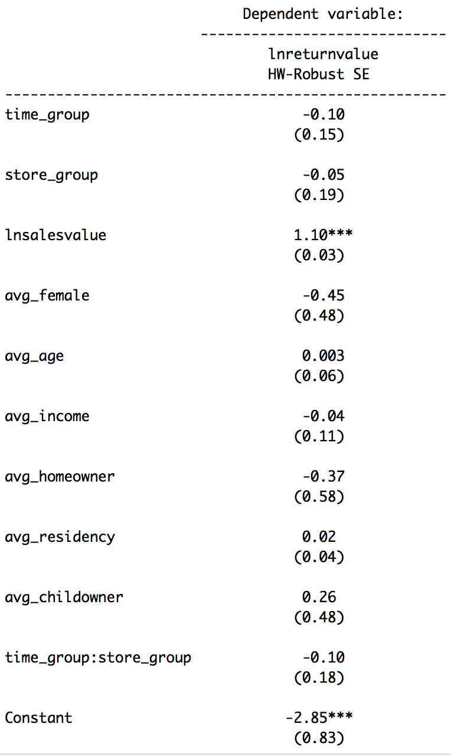
Results - Online return value
1 Coefficient of interaction term
Is insignificant
-0.10
(0.18)
Insignificant Impact

Slide 34
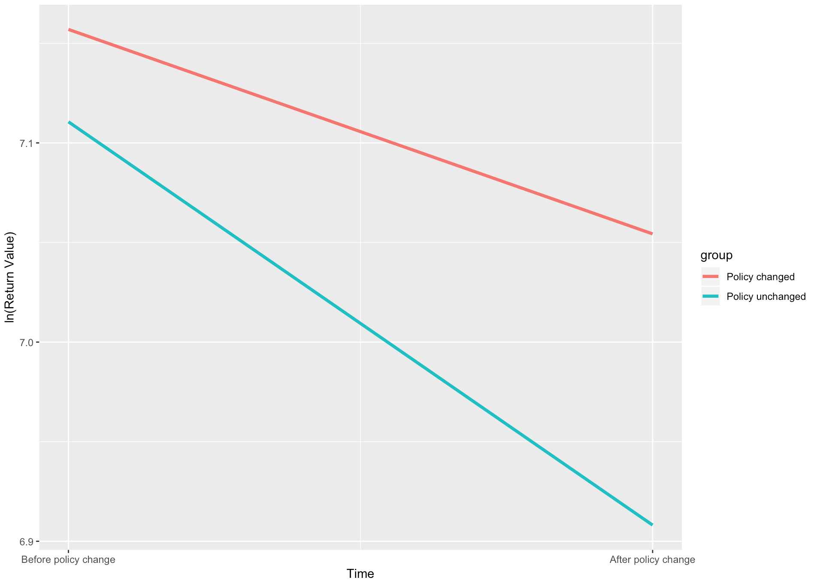
Results - Online return value
2 Marginal Plot
Almost Parallel
Insignificant Impact

Slide 35
Theoretical Model
Variable Description
1 for Treatment group, return policy change
policy_change =
0 for Control group return, policy didn’t change
1 after policy change
month_group =
0 before policy change
For ONLINE Return Quantity
Negative Binomial model
Returnquantity ~ month_group*policy_change + ln(salesquantity) +
avg_female + avg_age + avg_income + avg_homeowner +
avg_residency +avg_childowner

Slide 36
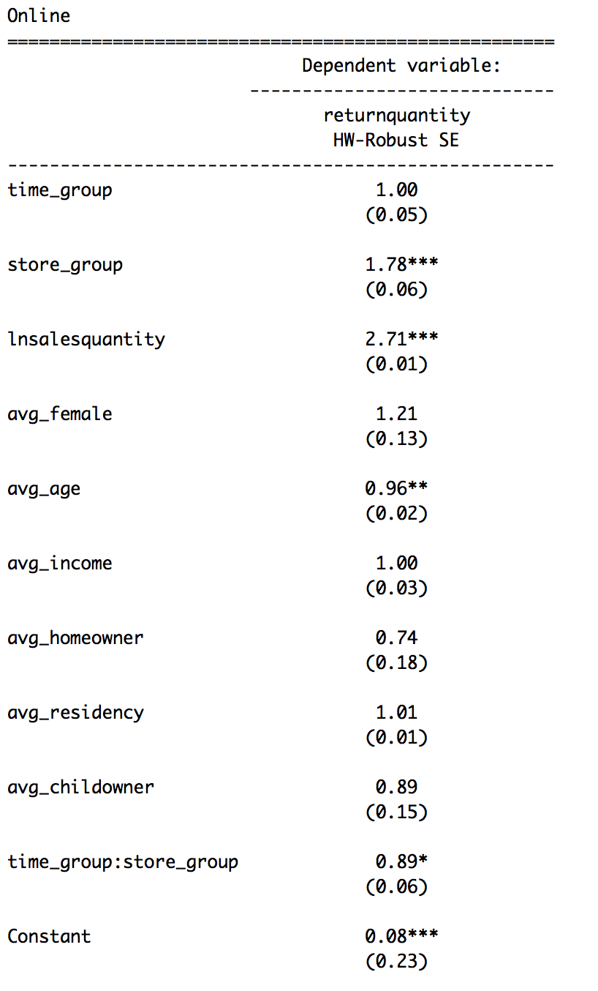
Results - Online return quantity
1 Coefficient of interaction term
0.89*
(0.06)
Decrease 11% on return quantity
Significant Impact

Slide 37
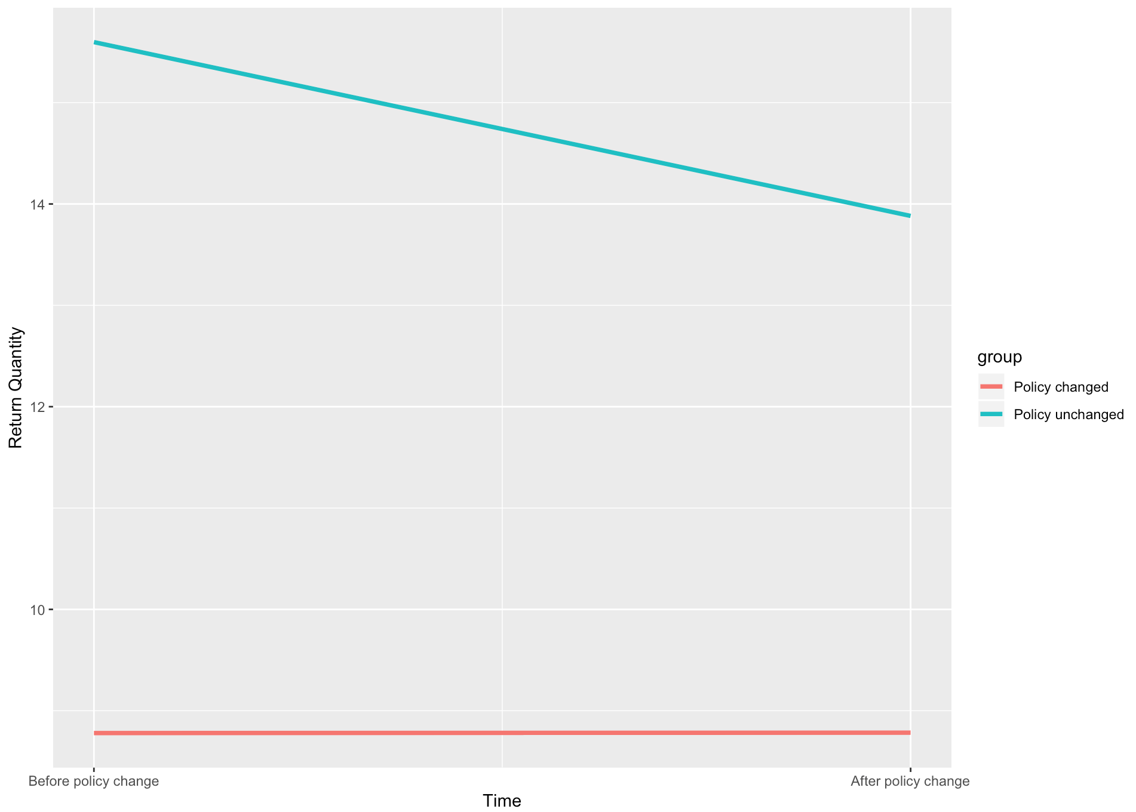
Results - Online return quantity
2 Marginal Plot
Decrease in return quantity
Significant Impact

Slide 38
Conclusion - Online Return
Return policy change has no significant impact on online return value
Return policy change lead to 11% decrease on online return quantity.

Slide 39
Research Question 4
What is the impact of the policy change on
physical store returns?

Slide 40
Sample Summary - Store Return
Total Number = 8957 (sample size)
Mean Max Min
Store return value 11, 569 142,150 0
Store return quantity 26.8 225 0
Customer Demographics
Seasonality

Slide 41
Variables - Store Return
Dependent Variables:

Slide 42
Theoretical Model
Variable Description
1 for Treatment group, return policy change
policy_change =
0 for Control group return, policy didn’t change
1 after policy change
month_group =
0 before policy change
For STORE Return Value
ln (returnvalue+1) ~ policy_change + month_group + avg_female +avg_age + avg_income + avg_homeowner + avg_residency + avg_childowner +store_average_price + log(store_number_of_skus) + sa_gender + sa_full_time + sa_avg_years_of_exp + sa_married + sa_avg_rate_of_pay + store_average_price+sa_dependent + month_group*policy_change

Slide 43
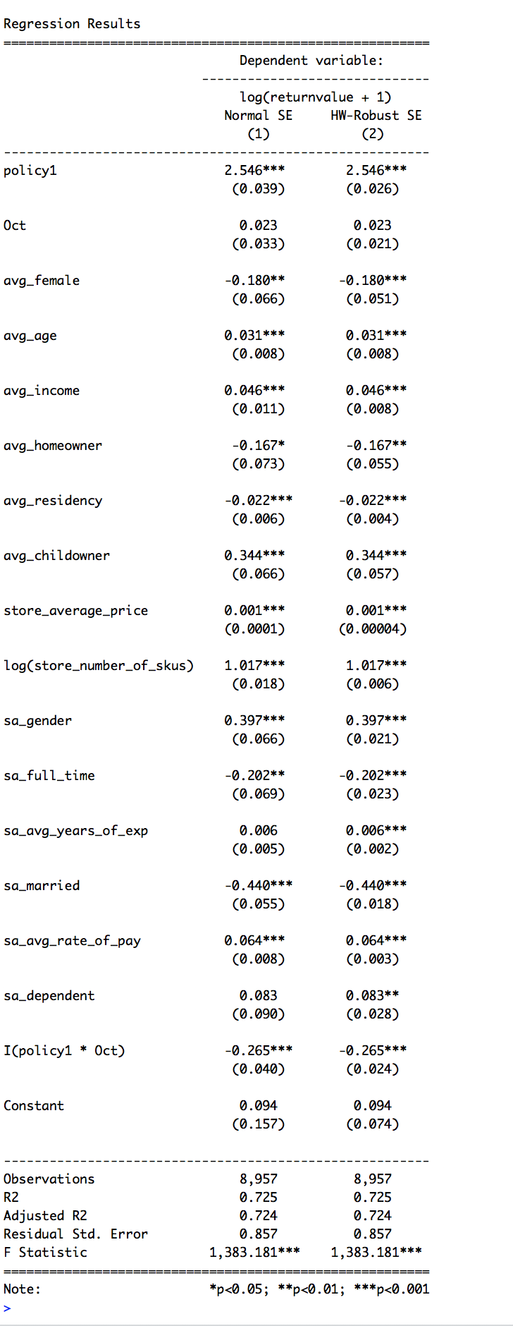
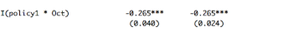
Results - Store return value
Coefficient of interaction term
-0.265***
(0.024)
26.5% decrease in return value
Significant Impact

Slide 44
Theoretical Model
Variable Description
1 for Treatment group, return policy change
policy_change =
0 for Control group return, policy didn’t change
1 after policy change
month_group =
0 before policy change
For STORE Return Quantity
Returnquantity ~ policy_change + month_group + avg_female + avg_age + avg_income + avg_homeowner + avg_residency + avg_childowner + store_average_price + sa_gender + sa_full_time + sa_avg_years_of_exp + sa_married + sa_avg_rate_of_pay + store_average_price + sa_dependent + month_group*policy_change

Slide 45
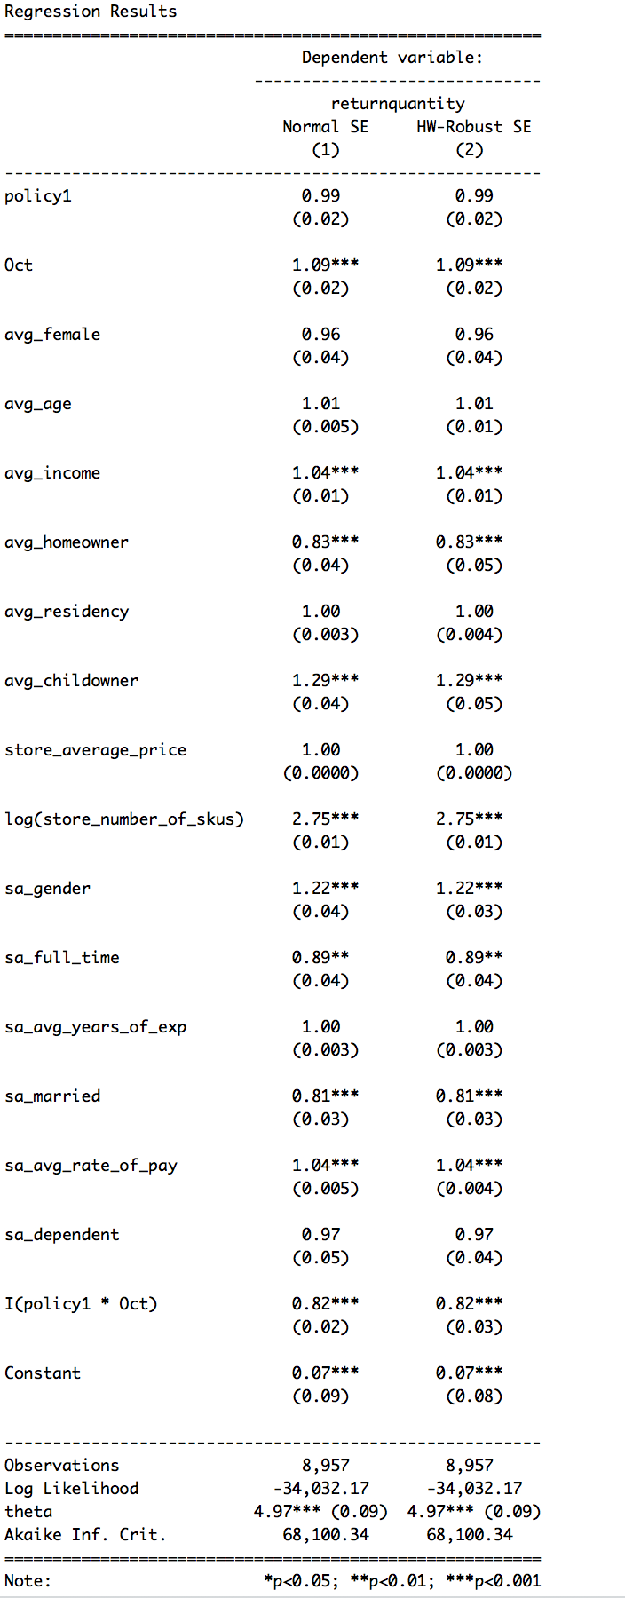
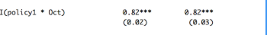
Results - Store return quantity
Coefficient of interaction term
0.82***
(0.03)
18% decrease in return quantity
Significant Impact
100* (82%-1) = -18%

Slide 46
Conclusion
Return policy change leads to 26.5% decrease in return value
Return policy change leads to 18% decrease in return quantity
Customers tend to return higher value products

Slide 47
Research Question 5
What is the impact of the policy change on product level online sales and returns as well as on product level physical store sales and returns?

Slide 48
Theoretical Model
Variable Description
1 for Treatment group, return policy change
policy_change =
0 for Control group return, policy didn’t change
1 after policy change
month_group =
0 before policy change
For ONLINE Sales Value
ln(salesvalue) ~ month_group*policy_change + avg_female + avg_age + avg_income + avg_homeowner +avg_childowner+ avg_residency+ pcfactor

Slide 49
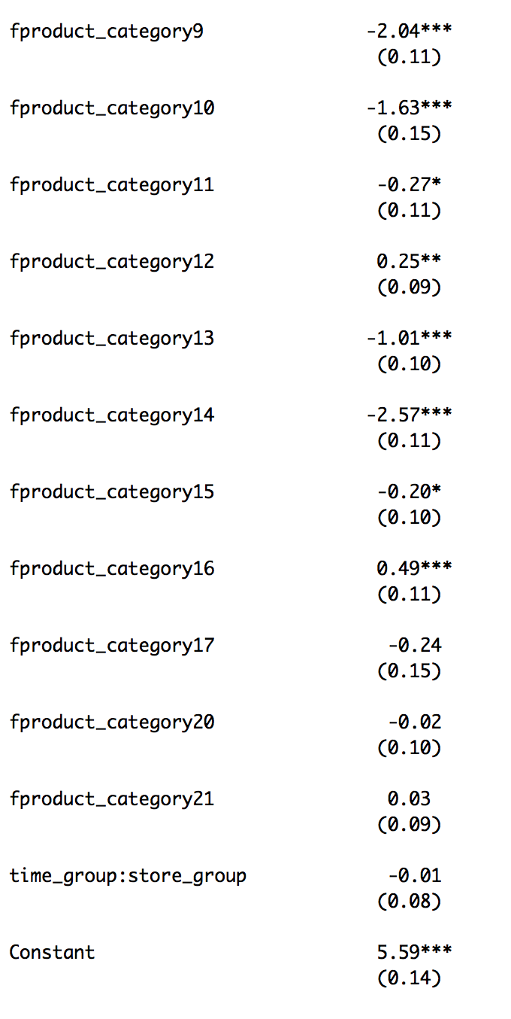
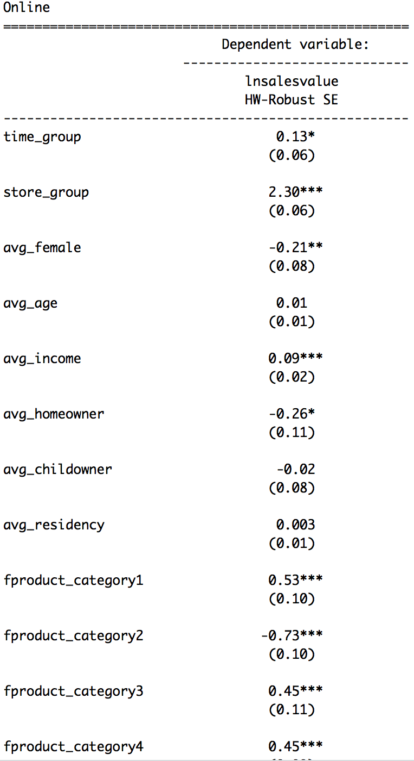
Results -
Online sales value
Coefficient: -0.01
(0.08)
Impact of return policy change on ln(salevalue) is insignificant
Insignificant

Slide 50
Theoretical Model
Variable Description
1 for Treatment group, return policy change
policy_change =
0 for Control group return, policy didn’t change
1 after policy change
month_group =
0 before policy change
For ONLINE Sales Quantity
Salesquantity ~ month_group*policy_change+ avg_female + avg_age + avg_income + avg_homeowner + avg_childowner + pcfactor

Slide 51
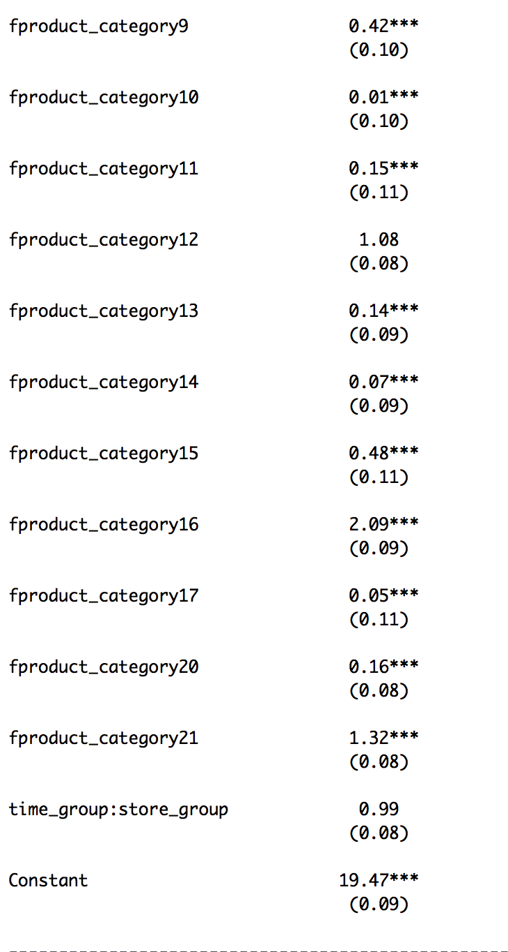
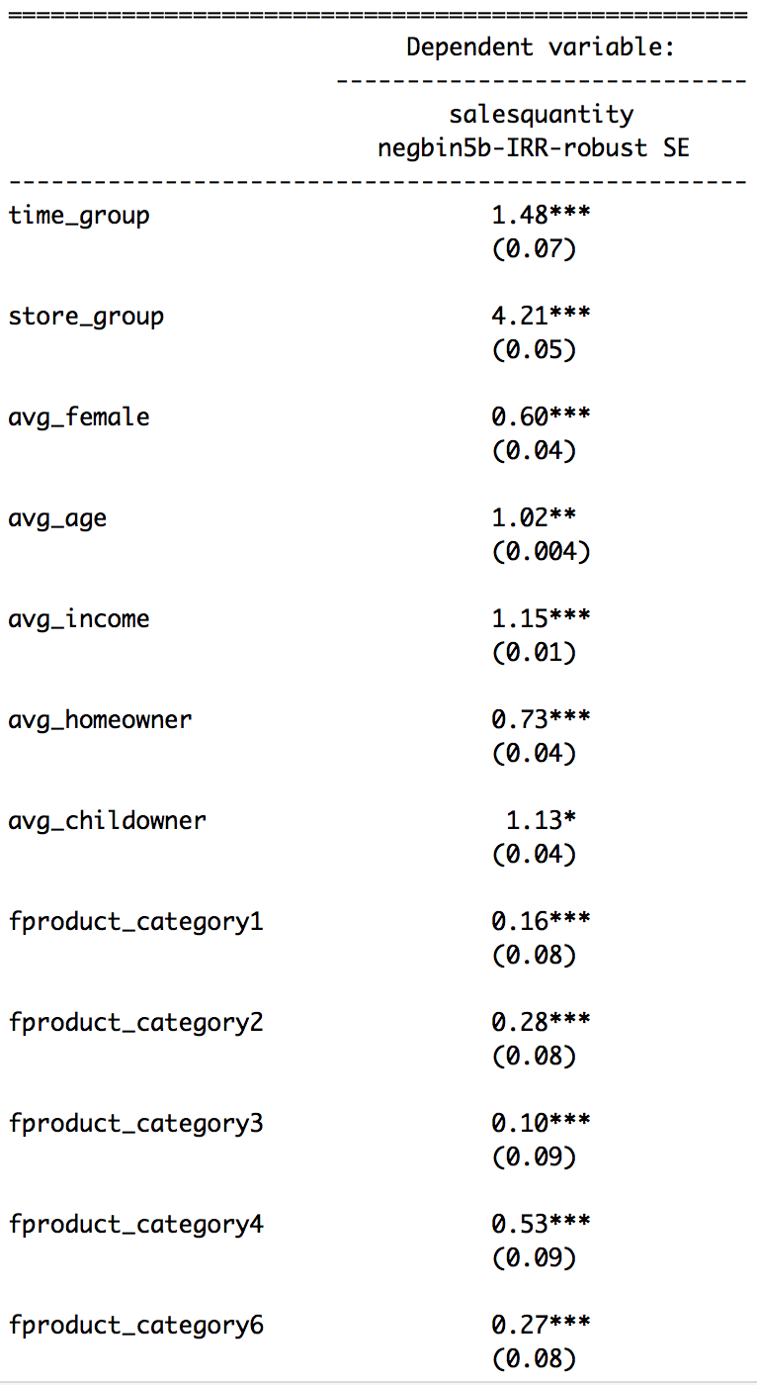
Results -
Online sales quantity
Coefficient：0.99
(0.08)
Impact of return policy change on salesquantity is insignificant
Insignificant

Slide 52
Conclusion- Online Sales
Return policy change has no significant impact on online sales value
Return policy change has no significant impact on online sales quantity.

Slide 53
Theoretical Model
Variable Description
1 for Treatment group, return policy change
policy_change=
0 for Control group return, policy didn’t change
1 after policy change
month_group =
0 before policy change
For ONLINE Return Value
ln(returnvalue) ~ month_group*policy_change+ ln(salesvalue) +
avg_female + avg_age + avg_income + avg_homeowner +
+ pcfactor

Slide 54
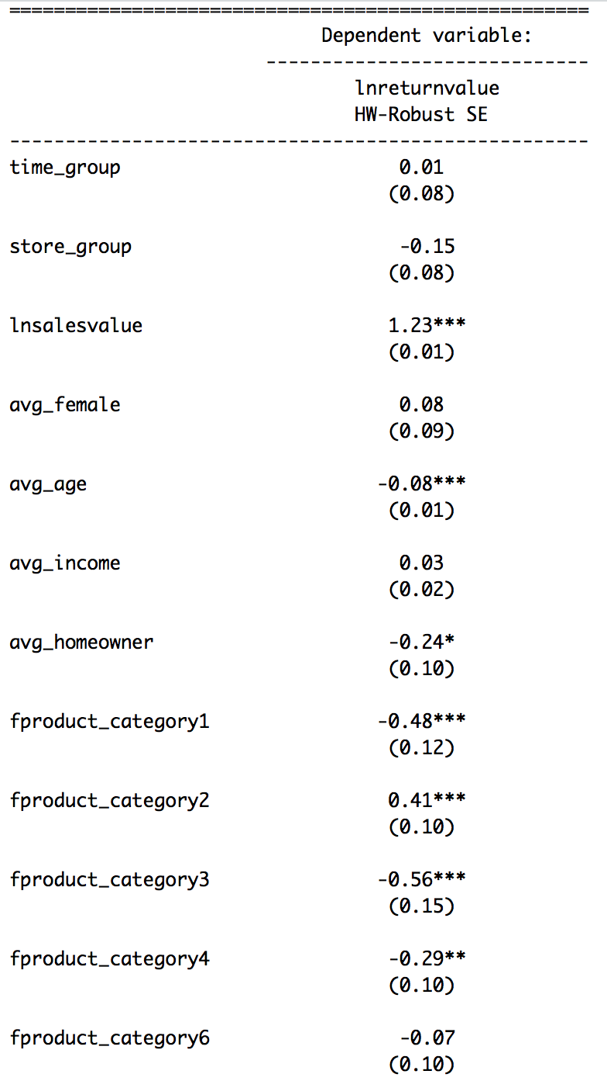
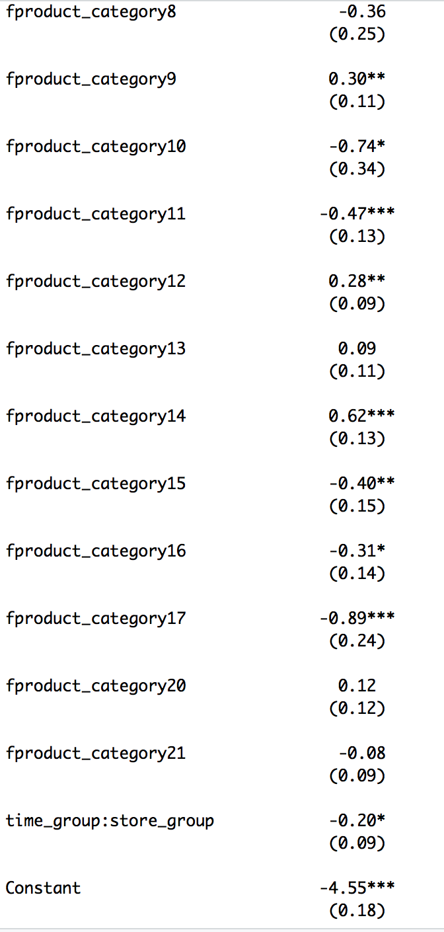
Results -
Online return value
Coefficient: -0.20*
(0.09)
Decrease 20% on
return value
Significant Impact

Slide 55
Theoretical Model
Variable Description
1 for Treatment group, return policy change
policy_change=
0 for Control group return, policy didn’t change
1 after policy change
month_group =
0 before policy change
For ONLINE Return Quantity
Negative Binomial model
Returnquantity ~ month_group*policy_change+ ln(salesquantity) +
avg_female + avg_age + avg_income + avg_homeowner +
avg_residency + avg_childowner + pcfactor

Slide 56
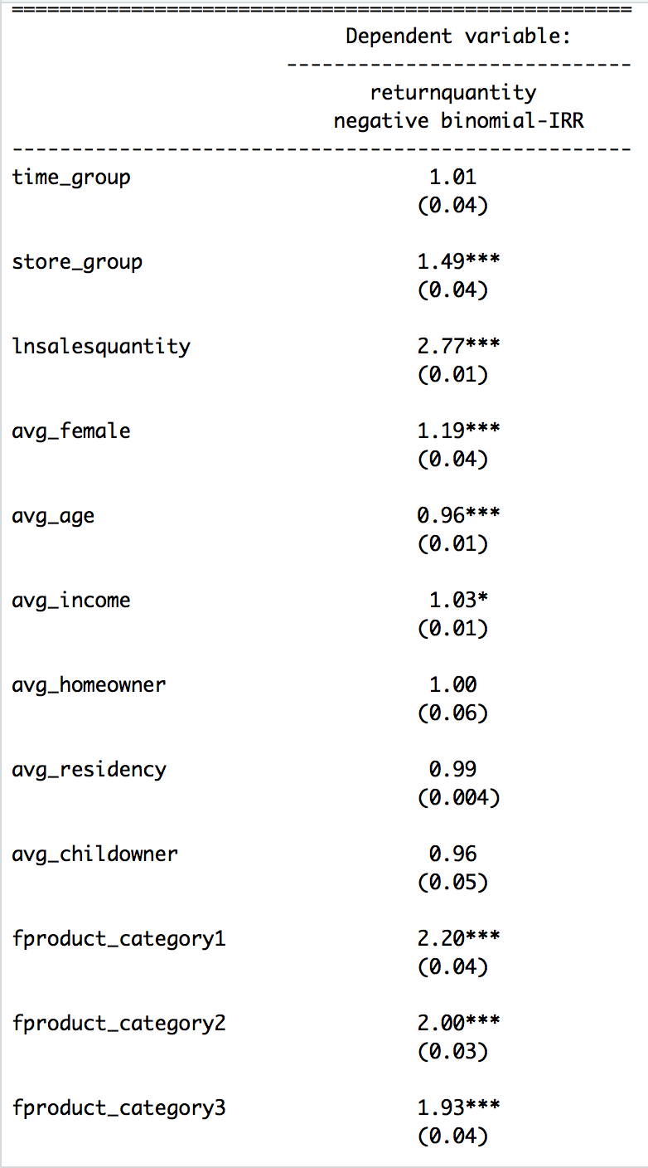
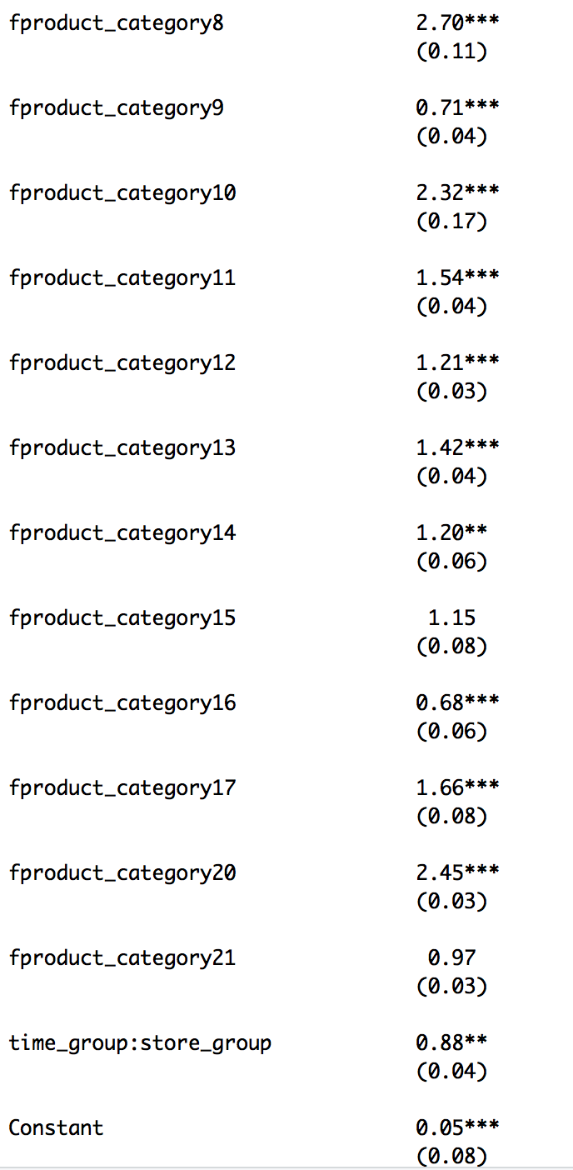
Results -
Online return quantity
Coefficient: 0.88**
(0.04)
Decrease 12% on
return quantity
Significant Impact

Slide 57
Conclusion - Online Return
Return policy change leads to 20% decrease in online return value
Return policy change leads to 12% decrease in online return quantity

Slide 58
Theoretical Model
Variable Description
1 for Treatment group, return policy change
policy_change =
0 for Control group return, policy didn’t change
1 after policy change
month_group =
0 before policy change
For STORE Sales Value
ln(salesvalue+1) ~ pcfactor+avg_female +avg_age + avg_income + avg_homeowner + avg_residency + avg_childowner +store_average_price + ln(store_number_of_skus) + sa_gender + sa_full_time + sa_avg_years_of_exp + sa_married + sa_avg_rate_of_pay + store_average_price+sa_dependent + policy_change * month_group

Slide 59
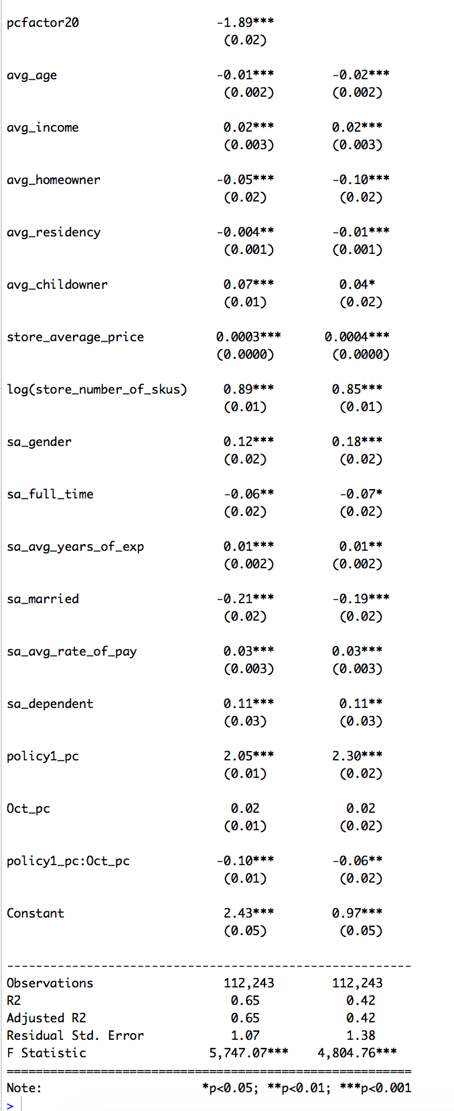
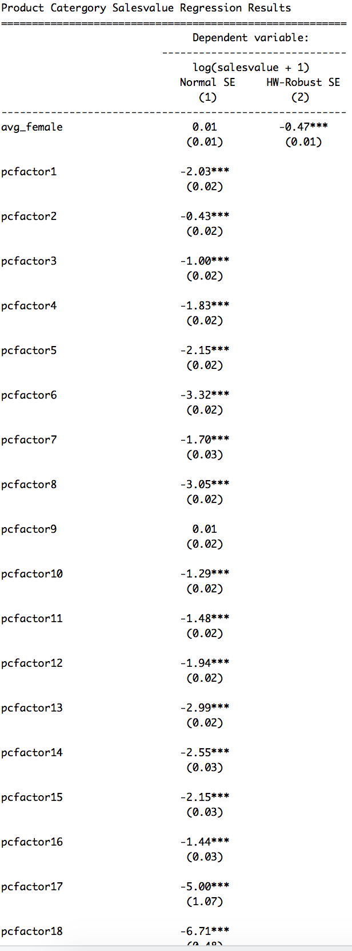
Results -
Store sales value
Coefficient: -0.06**
(0.02)
Decrease 6% on sales value
Significant

Slide 60
Theoretical Model
Variable Description
1 for Treatment group, return policy change
Policy_change =
0 for Control group return, policy didn’t change
1 after policy change
Month_group =
0 before policy change
For STORE Sales Quantity
Salesquantity ~ pcfactor + avg_female + avg_age + avg_income + avg_homeowner + avg_residency + avg_childowner + store_average_price + sa_gender + sa_full_time + sa_avg_years_of_exp + sa_married + sa_avg_rate_of_pay + store_average_price + sa_dependent +
policy_change * month_group

Slide 61
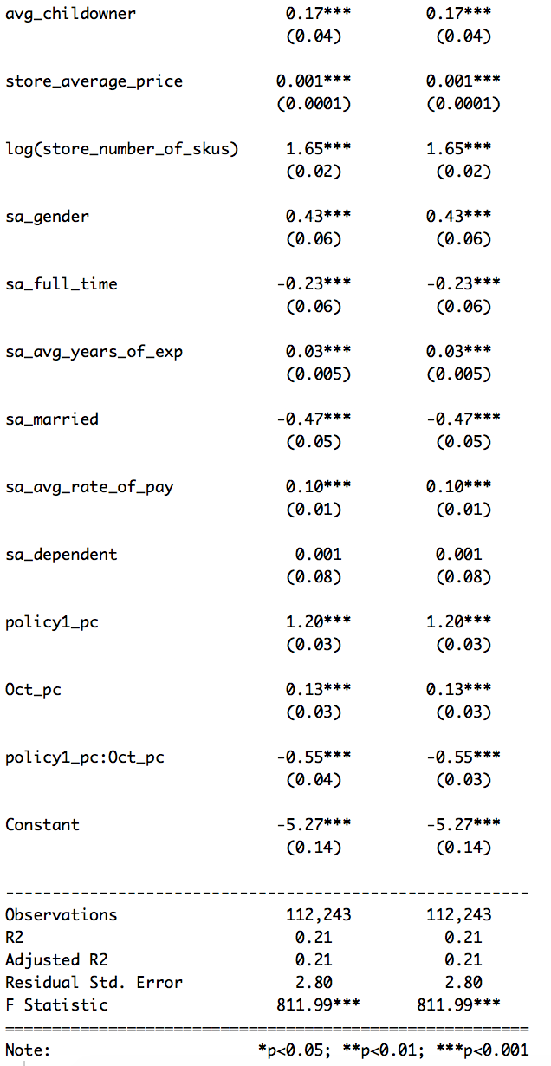
Results -
Store sales quantity
Coefficient：-0.55***
(0.03)
Decrease 55% on sales quantity
Significant

Slide 62
Conclusion - Store Sales
Return policy change leads to 6% decrease in store sales value
Return policy change leads to 55% decrease in store sales quantity

Slide 63
Theoretical Model
Variable Description
1 for Treatment group, return policy change
policy_change =
0 for Control group return, policy didn’t change
1 after policy change
month_group =
0 before policy change
For STORE Return Value
ln (returnvalue+1) ~ pcfactor + avg_female +avg_age + avg_income + avg_homeowner + avg_residency + avg_childowner +store_average_price + log(store_number_of_skus) + sa_gender + sa_full_time + sa_avg_years_of_exp + sa_married + sa_avg_rate_of_pay + store_average_price+sa_dependent + policy_change * Month_group

Slide 64
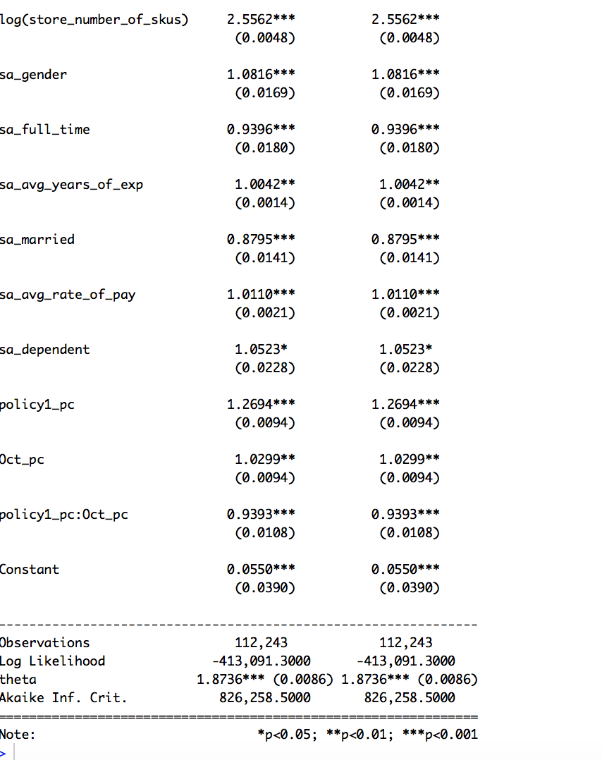
Results -
Store return value
Coefficient: 0.9393***
(0.0108)
Decrease 6.07% on
return value
Note: (0.9393-1)*100% = 6.07%
Significant Impact

Slide 65
Theoretical Model
Variable Description
1 for Treatment group, return policy change
Policy_change =
0 for Control group return, policy didn’t change
1 after policy change
Month_group =
0 before policy change
For STORE Return Quantity
Returnquantity ~ pcfactor + avg_female + avg_age + avg_income + avg_homeowner + avg_residency + avg_childowner + store_average_price + sa_gender + sa_full_time + sa_avg_years_of_exp + sa_married + sa_avg_rate_of_pay + store_average_price + sa_dependent +
Policy_change* Month_group

Slide 66
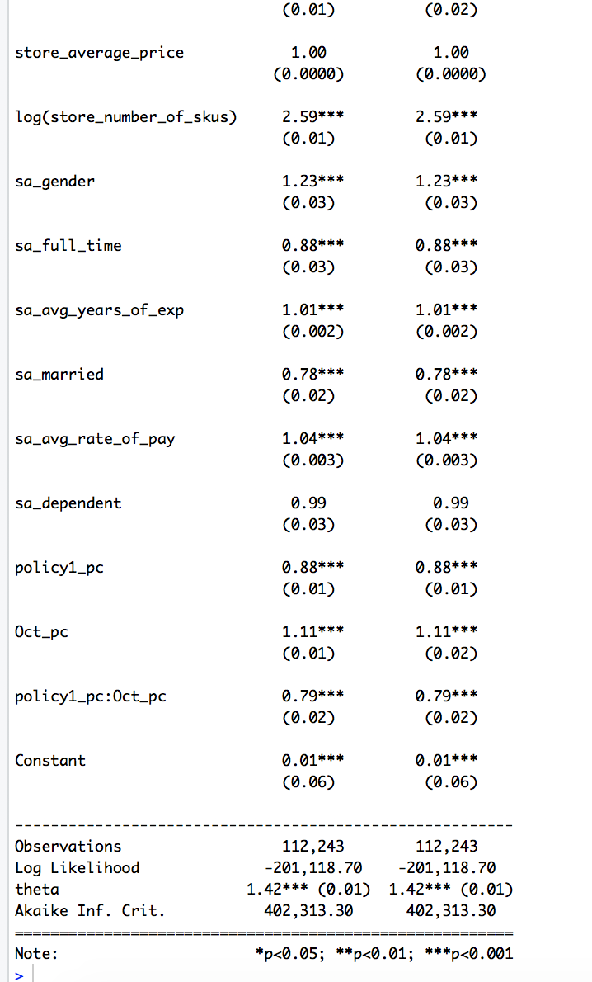
Results -
Store return quantity
Coefficient: 0.79***
(0.02)
Decrease 21% on
return quantity
Note: (0.79-1)*100% = 21%
Significant Impact

Slide 67
Conclusion - Store Return
Return policy change leads to 6.07% decrease in store return value
Return policy change leads to 21% decrease in store return quantity

Slide 68
Conclusion Summary - Question 5
 | Online |  |  |  | Store
 | Sales Value | Sales Quantity | Returns Value | Returns Quantity | Sales Value | Sales Quantity | Returns Value | Returns Quantity
Coefficient (P-value) | -0.01 (0.08) | 0.99 (0.08) | -0.20* (0.09) | 0.88** (0.04) | -0.06** (0.02) | -0.55*** (0.03) | 0.9393*** (0.0108) | 0.79*** (0.02)
Significant? | N | N | Y | Y | Y | Y | Y | Y
Impact | No significant impact | No significant impact | 20% Decrease | 12% Decrease | 6% Decrease | 55% Decrease | 6.07% Decrease | 21% Decrease

Slide 69
Research Question 6
How does the impact of the policy change vary across product categories?

Slide 70
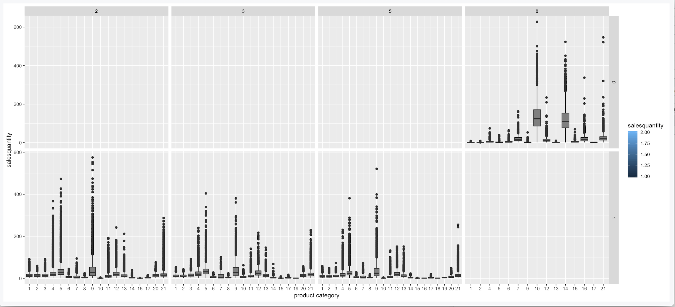
Sample Summary
Store side, Brand8, the policy control group doesn't cover product categories: 3,8,11,18,19,20, 17(only one data), we are unable to compare the return policy change for these product categories

Slide 71
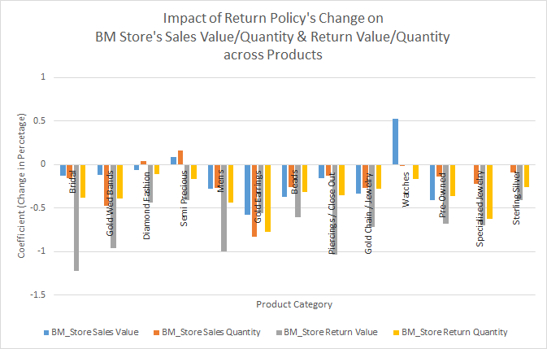
Results - Visual Overview
Store

Slide 72
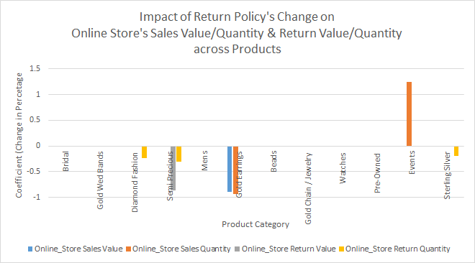
Results - Visual Demonstration
Online

Slide 73
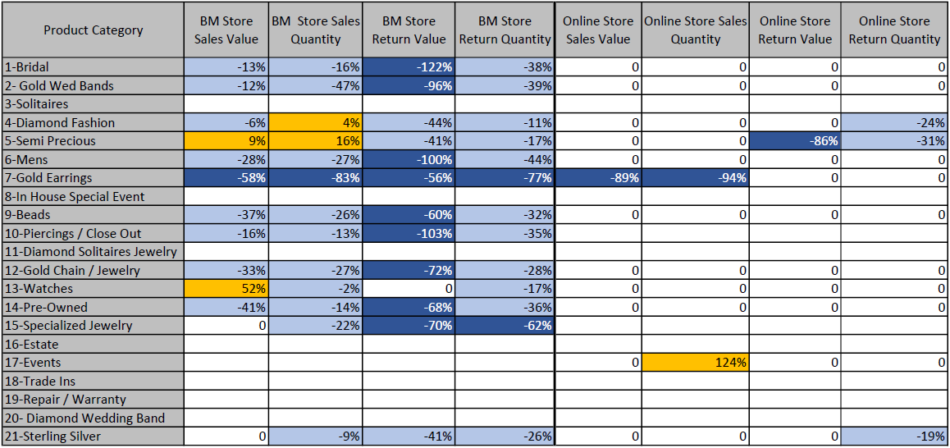
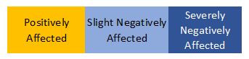
For BM_Store, Category 3-Solitaires, 8-In House Special Event, 11-Diamond Solitaires Jewelry, 16-Estate. 17-Events, 18-Trade ins, 19-Repair / Warranty, 20-Diamond Wedding Band
All coefficients are significant; if insignificant, then 0.
Due to Negative Binomial Model, the actual change should be the coefficient of the key independent variable, beta, minus one = beta-1 (excluding the insignificant ones --- the 0’s).

Slide 74
Conclusion
Overall: the BM Stores were significantly negatively affected by the reduce of return policy across most of the product categories, resulting lower value and quantity of sales as well as lower value and quantity of return¹.
Physical Store’s reduction on return value and quantity outweighed the loss on sales value and quantity proportionally, meaning customers have not return as easily as before the policy took place.
Online Stores were negligibly affected by the change of return policy, as most of the changes remain insignificant.
1.Note: a negative impact on return value & quantity, or having less returns, is desired by the firm.

Slide 75
Conclusion - Product Level
Gold Earrings is the most affected product under the new return policy. The value and quantity of sales and return decreased seemingly with the same proportion, complimented by a drastic decrease on sale through the online channel. A possible conclusion is customers lost the interest on gold earrings due to the new return policy.
While products such as Semiprecious, Diamond Fashion, Specialized Jewelry enjoying a dramatic decrease of returns, their sales remained a steady level or even improved.

Slide 76
CONTENTS
03
Part Three
Limitations

Slide 77
Limitation
Analysis Results from Question 2：in physical stores, sales(without product categories) is against intuition
Intuition and previous researches shown that A shorter return policy period leads to decreases in sales.
Our result: A shorter Return policy period leads to increases in store sales (both for value & quantity)

Slide 78
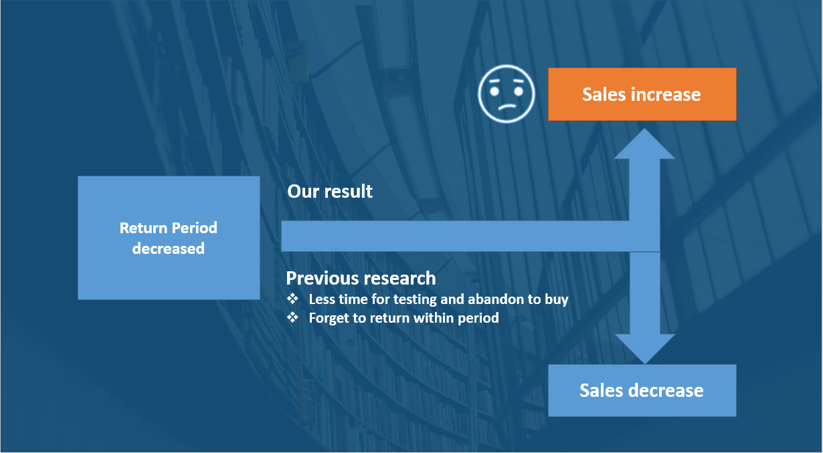

Slide 79
Limitation
2. From Analysis 6, the Physical Store’s reduction on return value and quantity outweighed the loss on sales value and quantity proportionally. However, whether the profit gain from less returns will equal or overtake the loss on sales revenue cannot be determined without further data.
3. It is rarely to observe an 100% increase on sales in business; it is impossible to have less than 100% loss on values. More data is needed to further investigate products, including Bridal, mens, piercings / close out, events, etc.

Slide 80
CONTENTS
04
Part Four
Appendix

Slide 81
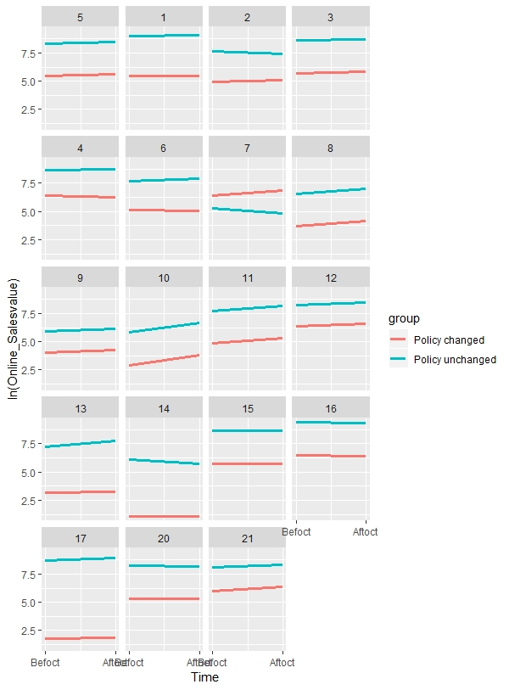
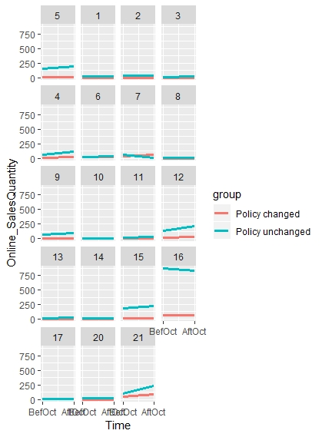
Appendix 1 - Online Sales
Online sales value
Online sales quantity

Slide 82
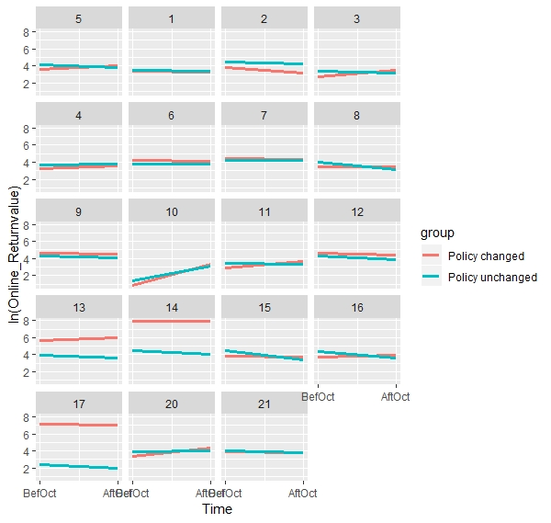
Appendix 2 - Online Return
Online return value

Slide 83
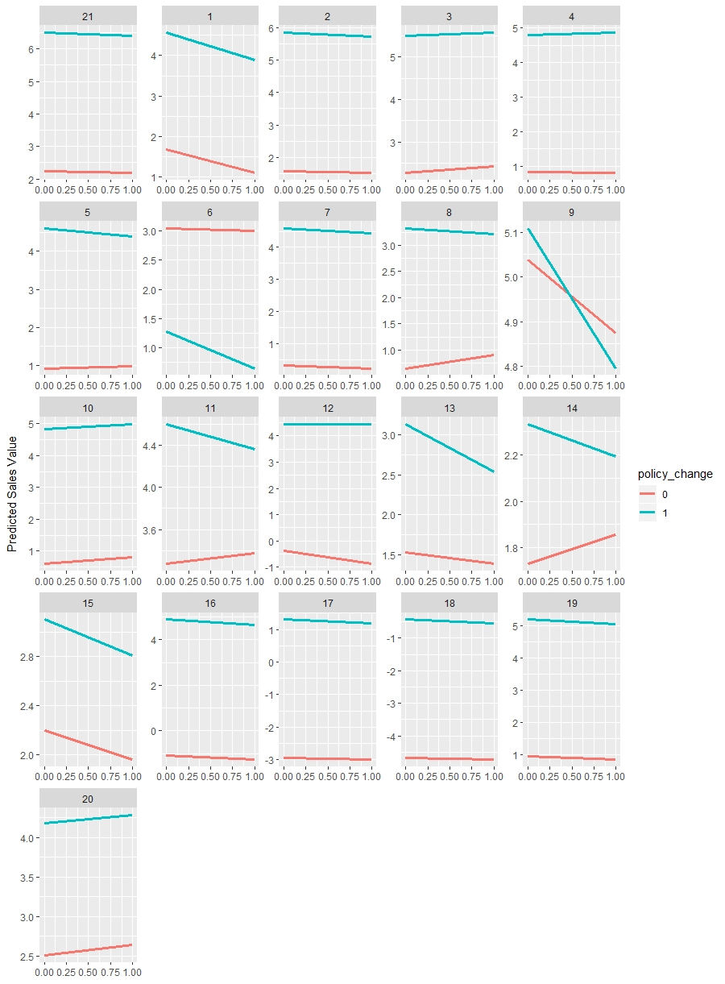
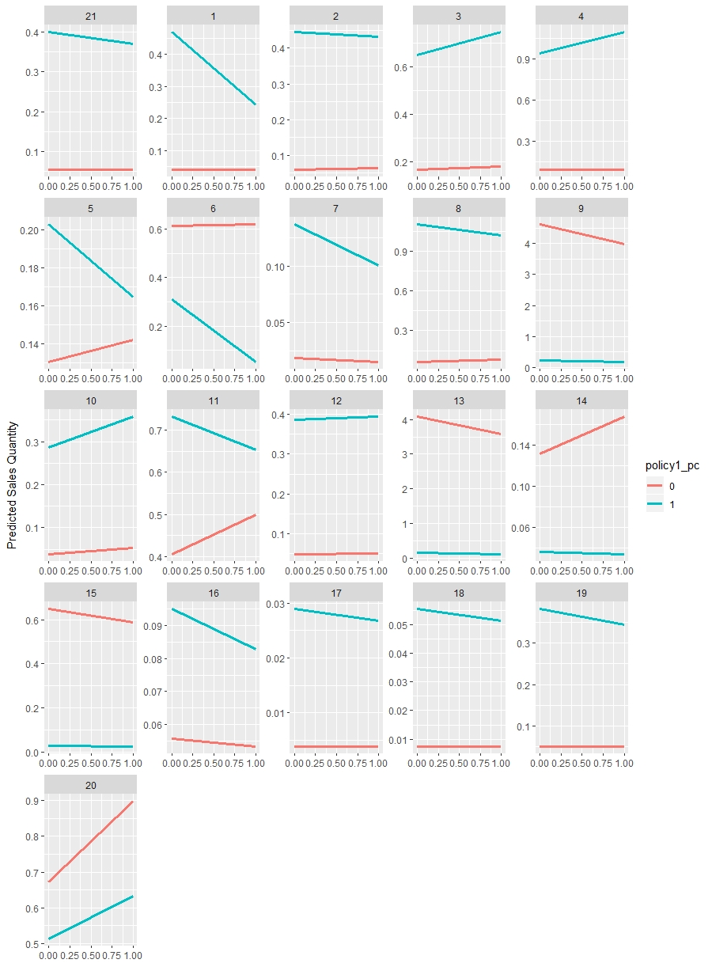
Appendix 3 - Store Sales
BM Store Sales Value
BM Store Sales Quantity

Slide 84
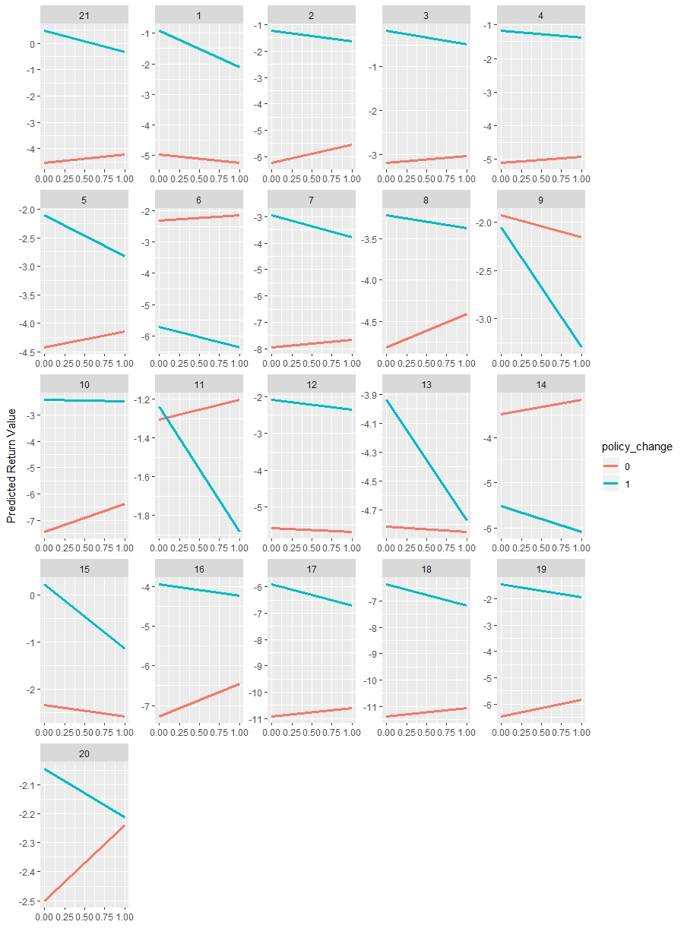
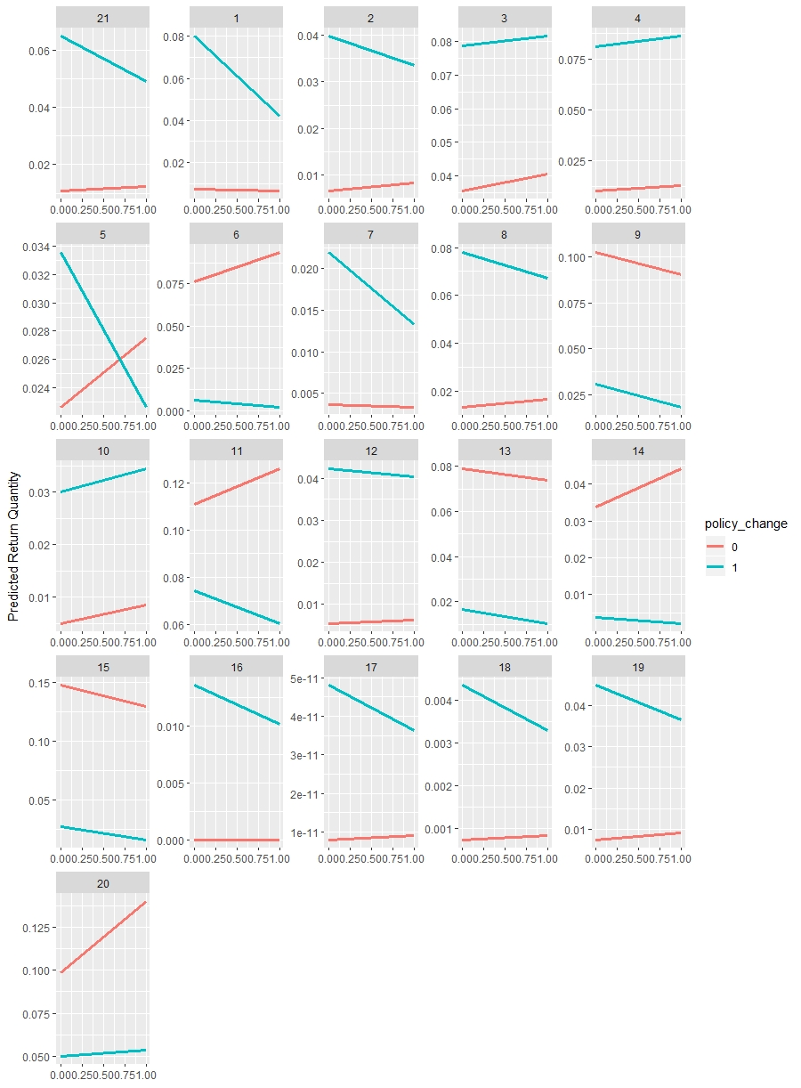
Appendix 4 - Store Return
BM Store Return Value
BM Store return quantity

Slide 85



